Slide 1
Like* Partner Data
December 11, 2020

Slide 2
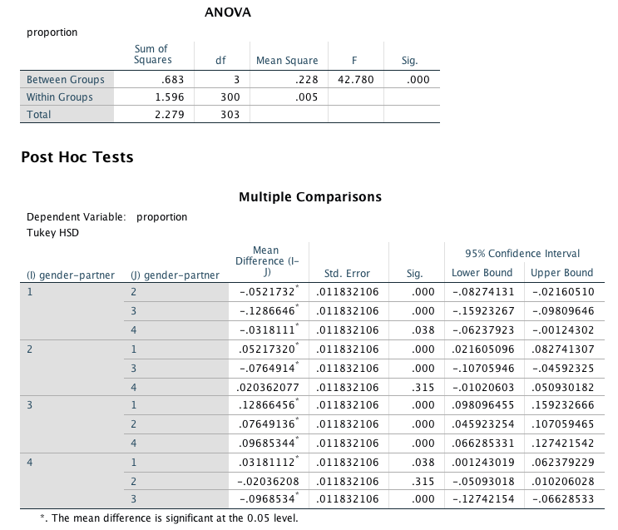
alone
male
female
both

Slide 3
.13 %
.06 %
.04 %
.006 %

Slide 4
To do next:
Random sampling to compare male vs. female participants
Like* alternatives (about, almost, approximately)
Parent data
Zip code data
Code “uh” and “um”

